Slide 1
Welcome! Google Chrome or Mozilla Firefox are the Browsers of Choice.

Slide 2
Bellwork
Create a student account in Edulastic and take a sample student assessment.
Navigate to Edulastic by doing one of the following:
Go to the WBM website, click on the Resources tab at the top, and click on Edulastic under Student Resources.
Type in www.edulastic.com into the browser address bar.
If you have been through training at WBM already, you have completed the next step. You do not need to complete the next slide.
If you have not been through training at WBM, you will need to complete the directions on the following slide.

Slide 3
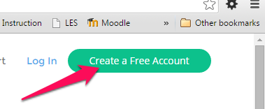
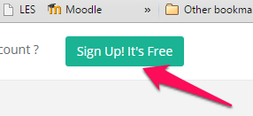
To Create a Student Account
Log back into Edulastic.com
Click "Create a Free Account"
Click "Sign Up! It's Free."
Select "As a Student"
Use the class code 45E1C to join today’s "class"
Put your first and last name.
DO NOT Enter an Email Address- Use your first name initial, your last name, and 1234 as the username (i.e. "kweller1234"). Use your computer login password.
Select the Active Assignment, “Teacher Practice 1”.

Slide 4
Today's Agenda
Wearing the "Student Hat" to understand your students’ experience of Edulastic
Explore Student Account Features
Reviewing the Sample Assessment and Reports from the Teacher Window
Creating Teacher Logins (if needed)
Explore Teacher Account Features
Creating Classes
Creating an Assessment by Selection
Discuss Creating Questions/Assessments from "Scratch“ (Review MICA)
Exit Ticket - PD Eval

Slide 5
As you complete the assignment, what features do you notice are available to students? Be prepared to share with the group.
Explore Student Account Features -
Dashboard - Look at Progress
Assignments - Select Assignment to view grade, Select Question to view response and teacher feedback
Skill Report
Manage Classes - Add Additional
My Profile - Adding a picture, Change Profile, Change Username or Password

Slide 6
Teacher Account Features
Dashboard
Assignments
Create New Assignment
View Draft Status- Edit assignments
Assessment Library
Find Assessments created by other users
Select Customize to save it to your account
Select Add More to add additional Questions
My Assessments
You can customize your assessments
Reports
Manage Classes
Report Issues

Slide 7
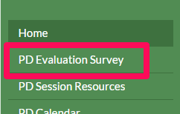
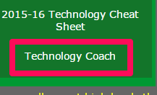
Exit Ticket
Go to Mrs. Weller’s webpage by returning to the WBM webpage, going to Resources, and clicking on the Technology Coach link under Teacher Resources.
OR
Go to http://wellertechcoach.weebly.com
Click on the PD Evaluation Survey Tab.
Complete the survey.
Have a great afternoon!

